Slide 1
Protein Structure Prediction by Evolutionary Multi-objective Optimization: Search Space Reduction by Using Rotamers
J.C. Calvo, J. Ortega, M. Anguita, J.M. Urquiza,
and J.P. Florido
IWANN 2009, Part I, LNCS 5517, pp. 861–868, 2009.
Speaker: Chun-Jen Chen
Date: Dec. 22, 2009

Slide 2
Abstract
The protein structure prediction (PSP) problem is considered an open problem as there is no recognized ”best” procedure to find solutions. Moreover, this problem presents a vast search space and the analysis of each protein conformation requires significant amount of computing time. We propose a reduction of the search space by using the dependent rotamer library. Also this work introduces new heuristics to improve the multi-objective optimization approach to this problem.
115/11/08

Slide 3
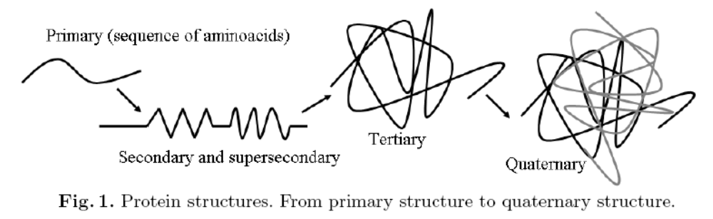
The super-secondary structure is the combination of two secondary structures by a short connecting peptide.
The quaternary structure refers to a protein built by two or more sequences. This structure defines the relations between the different sequences of the protein.

Slide 4
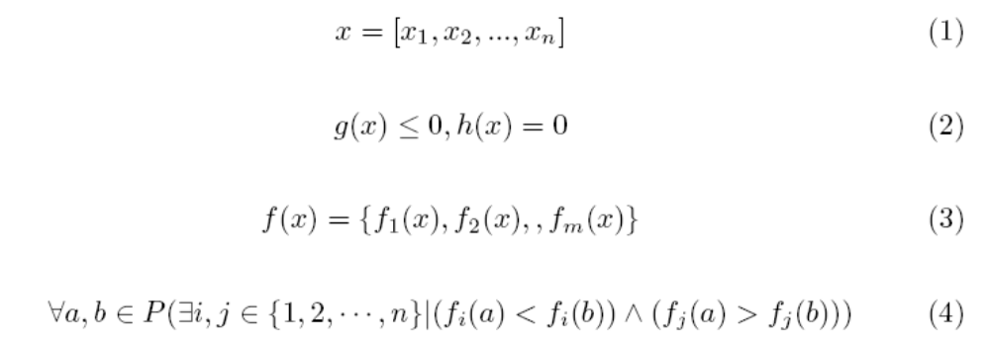
In a multi-objective optimization problem, a decision vector x* is said to be a Pareto optimal solution if there is not any other feasible decision vector, x, that improves one objective without worsening at least one of the other objectives

Slide 5
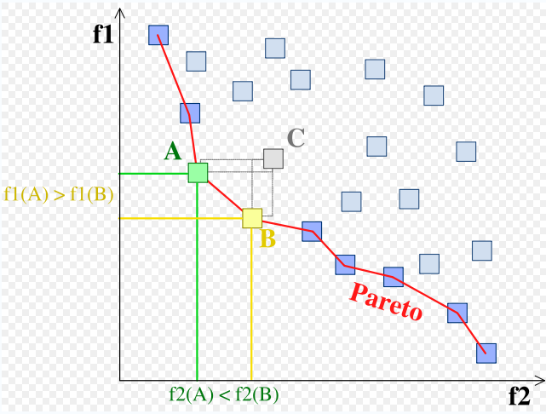
Pareto

Slide 6
This section describes the components required to solve the PSP problem by a multi-objective optimization using the ab initio approach. These components are:
The cost function
Initialization
The mutation operators
The set of variables.

Slide 7
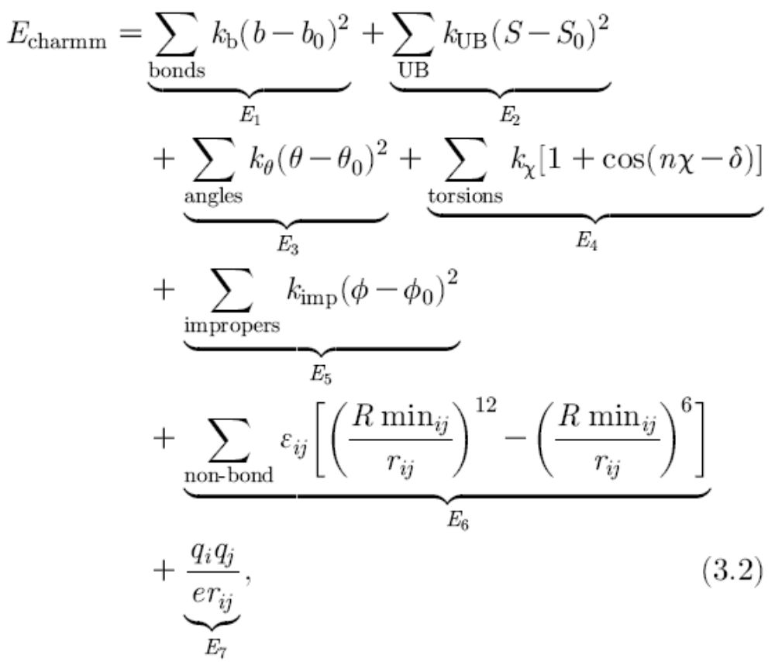

Slide 8
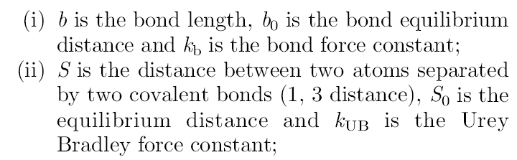
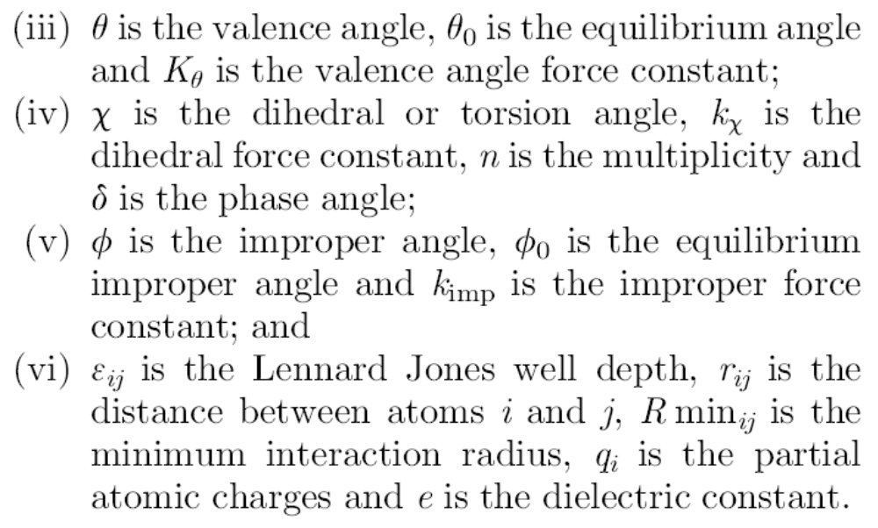

Slide 9
Set of variables
Any cost function depends on a set of variables that define the search space. These variables provide the required information to build the 3D conformation of the protein. In this paper we use torsion angles to represent the conformation of the protein, because this representation needs less variables than other alternatives. Three torsion angles are required in the backbone per each amino acid and some additional torsion angles depending on the side-chain.

Slide 10
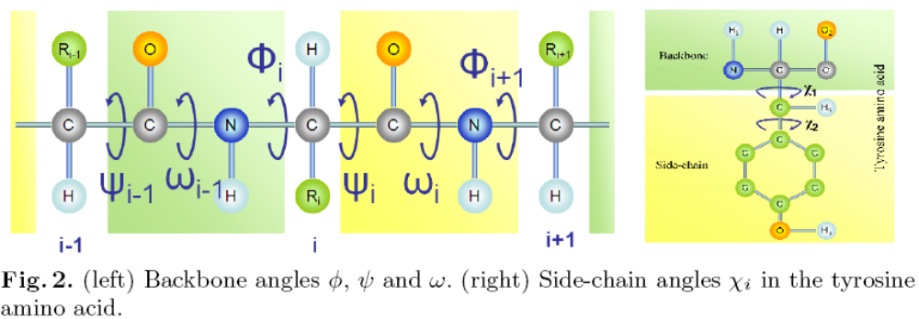
In many optimization problems, once a suitable cost function is found, it would not be difficult to obtain an efficient evolutionary algorithm that generates sufficient good solutions for the problem.
Some alternatives can be taken into account to reduce the search space such as secondary and super-secondary structure prediction and inclusion of rotamers libraries [11].
Rotamers libraries have statistical information about the conformation of the amino acids in known molecules.

Slide 11
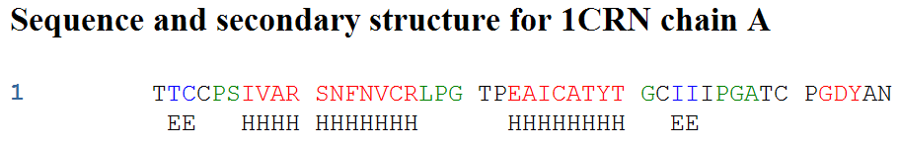
They are classified into five types, namely, a, b, e, l or t [12]. Sun et al. [12] developed a method to predict the eleven most frequently occurring super-secondary structures: H-b-H, H-t-H, H-bb-H, H-ll-E, E-aa-E, H-lbb-H, H-lba-E, E-aal-E, E-aaal-E and H-l-E where H and E are α helix and β strand, respectively. In this way a reduction in the search space of the PSP problem is obtained.

Slide 12
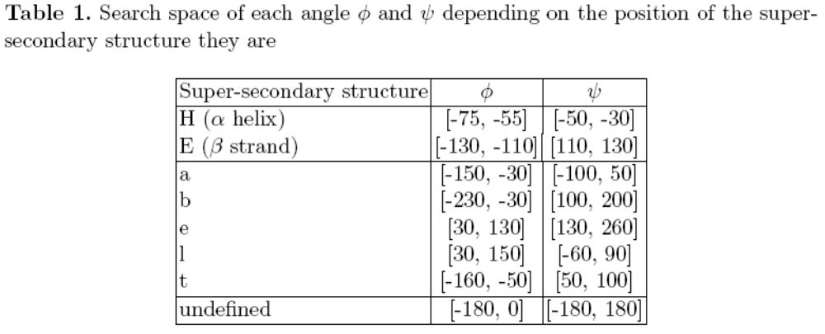

Slide 13
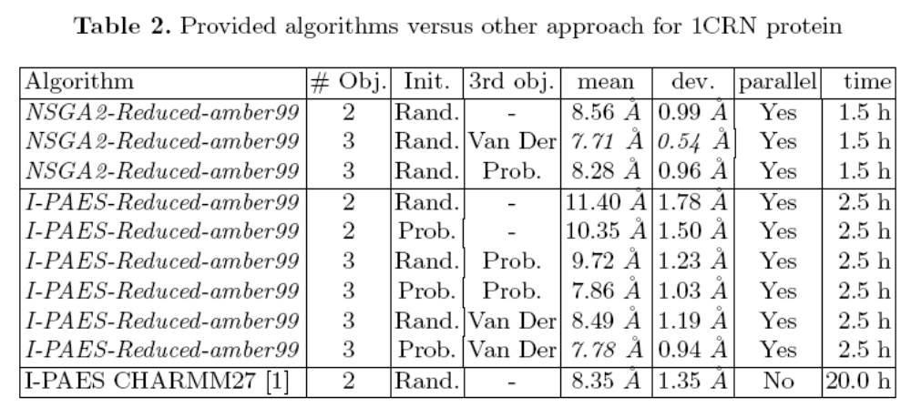
Results

